Slide 1
Partitioning Methods

Slide 2
Partitioning Methods
Given D, a data set of n objects, and k, the number of clusters to form, a partitioning algorithm organizes the objects into k partitions (k ≤ n), where each partition represents a cluster.
The clusters are formed to optimize an objective partitioning criterion, such as a dissimilarity function based on distance, so that the objects within a cluster are “similar,” whereas the objects of different clusters are “dissimilar” in terms of the data set attributes.

Slide 3
Partitioning Algorithms: Basic Concept
Partitioning method: Construct a partition of a database D of n objects into a set of k clusters
Classical Partitioning Methods:
k-means: Each cluster is represented by the center of the cluster
k-medoids or PAM (Partition Around Medoids) : Each cluster is represented by one of the objects in the cluster
Partitioning Methods in Large Databases:
CLARA
CLARANS

Slide 4
Centroid-Based Technique: The k-Means Method
The k-means algorithm takes the input parameter, k, and partitions a set of n objects into k clusters so that the resulting intracluster similarity is high but the intercluster similarity is low.
Cluster similarity is measured in regard to the mean value of the objects in a cluster, which can be viewed as the cluster’s centroid or center of gravity.

Slide 5

How does the k-means algorithm work?”
Randomly selects k of the objects, each of which initially represents a cluster mean or center.
For each of the remaining objects, an object is assigned to the cluster to which it is the most similar, based on the distance between the object and the cluster mean.
It then computes the new mean for each cluster.
This process iterates until the criterion function converges.
Typically, the square-error criterion is used, defined as
E is the sum of the square error for all objects in the data set
p is the point in space representing a given object
mi is the mean of cluster Ci

Slide 6
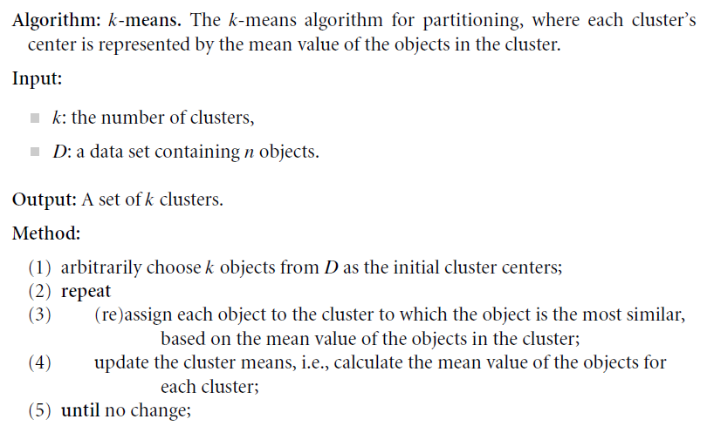

Slide 7
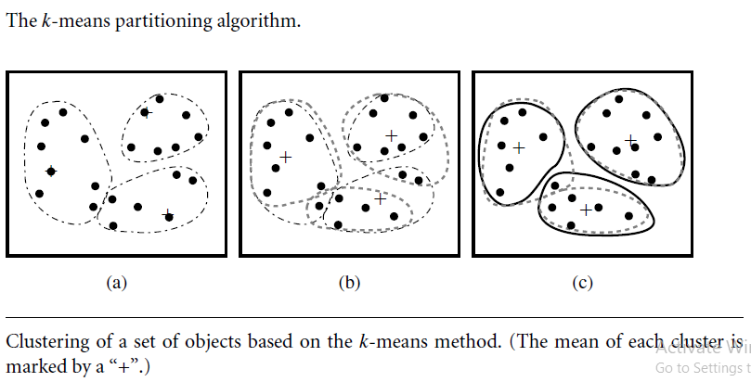
Clustering by k-means partitioning

Slide 8
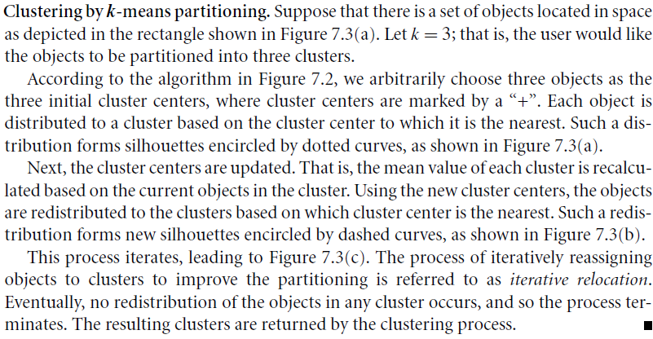

Slide 9
Comments on the K-Means Method
Strength: Relatively scalable and efficient in processing large data sets
Computational Complexity is O(nkt), where n is # objects, k is # clusters, and t is # iterations. Normally, k, t << n.
Weakness
Can be applied only when mean is defined.-> then what about categorical data?
Need to specify k, the number of clusters, in advance
Unable to handle noisy data and outliers- sensitive to noise and outlier data points because a small number of such data can substantially influence the mean value.
Not suitable to discover clusters with non-convex shapes or clusters of very different size

Slide 10
Variations of the K-Means Method
A few variants of the k-means which differ in
Selection of the initial k means
Dissimilarity calculations
Strategies to calculate cluster means
An interesting strategy -> first apply a hierarchical agglomeration algorithm, which determines the number of clusters and finds an initial clustering, and then use iterative relocation to improve the clustering.

Slide 11
Variations of the K-Means Method
Handling categorical data: k-modes
Replacing means of clusters with modes.
Using new dissimilarity measures to deal with categorical objects.
Using a frequency-based method to update modes of clusters.
The k-means and the k-modes methods can be integrated to cluster data with mixed numeric and categorical values.
EM (Expectation-Maximization) algorithm
In EM each object is assigned to each cluster according to a weight representing its probability of membership.
There are no strict boundaries between clusters.
Therefore, new means are computed based on weighted measures.

Slide 12
How can we make the k-means algorithm more scalable?
Recent approach based on the idea of identifying three kinds of regions in data:
regions that are compressible
regions that must be maintained in main memory
regions that are discardable.
An object is discardable if its membership in a cluster is ascertained.
An object is compressible if it is not discardable but belongs to a tight subcluster.
A data structure known as a clustering feature is used to summarize objects that have been discarded or compressed.
If an object is neither discardable nor compressible, then it should be retained in main memory.
To achieve scalability, the iterative clustering algorithm only includes the clustering features of the compressible objects and the objects that must be retained in main memory, thereby turning a secondary-memory based algorithm into a main-memory-based algorithm
Alternative approach – Micro Clustering

Slide 13
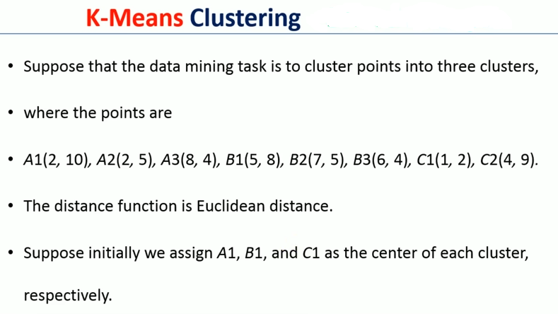

Slide 14
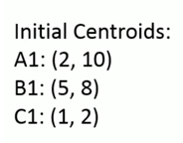
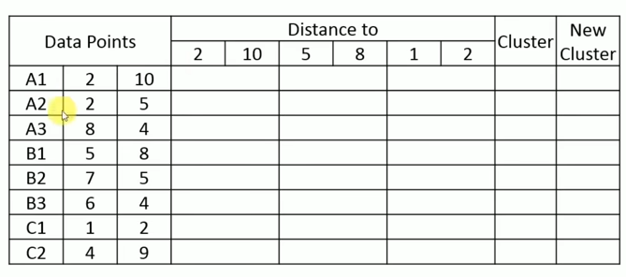

Euclidean Distance =

Slide 15
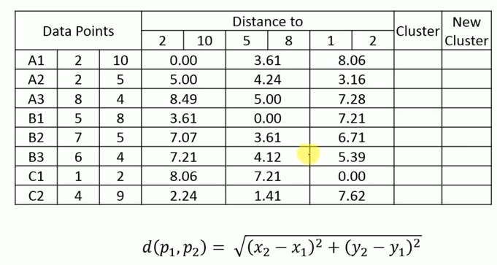

Slide 16
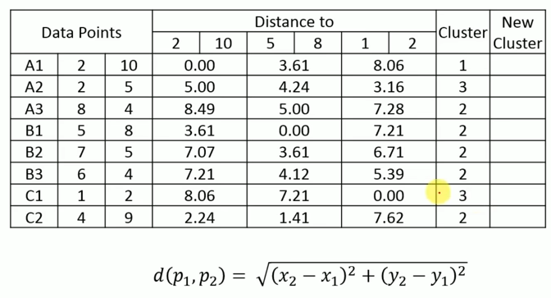
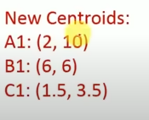

Slide 17
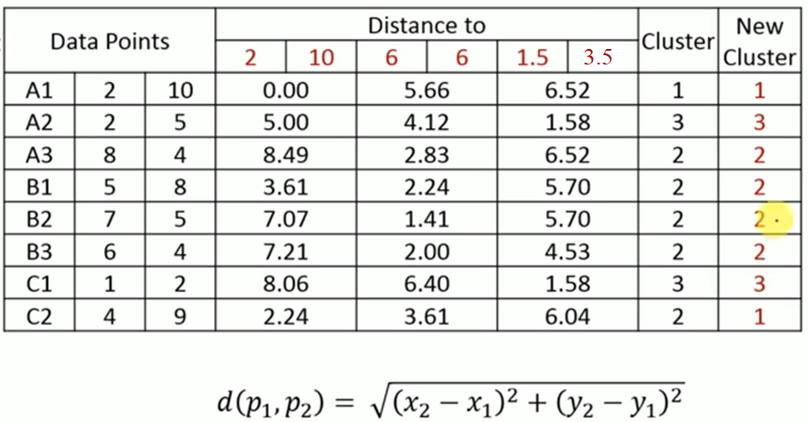
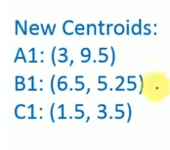

Slide 18
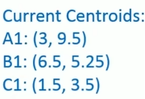
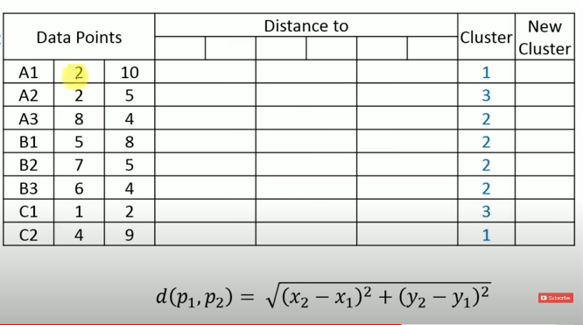

Slide 19
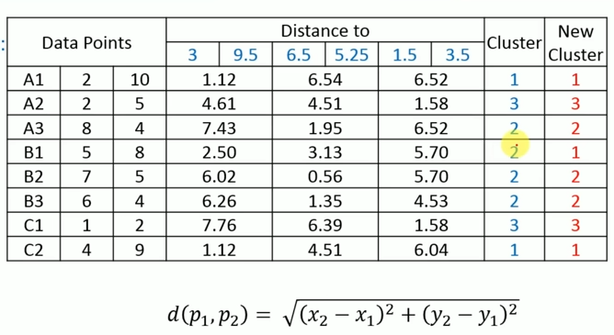
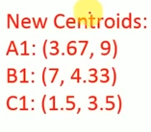

Slide 20
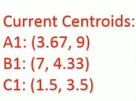
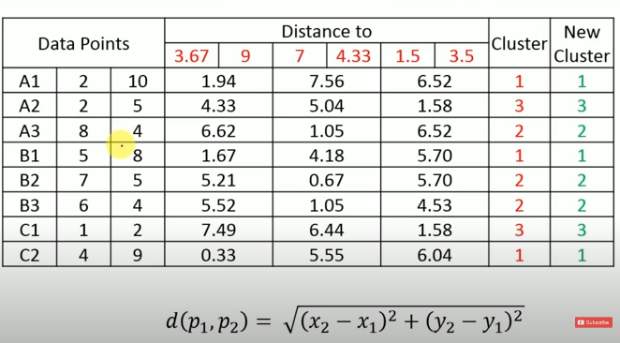

Slide 21
What Is the Problem of the K-Means Method?
The k-means algorithm is sensitive to outliers !
Since an object with an extremely large value may substantially distort the distribution of the data.
K-Medoids: Instead of taking the mean value of the object in a cluster as a reference point, medoids can be used, which is the most centrally located object in a cluster.
10
10
9
9
8
8
7
7
6
6
5
5
4
4
3
3
2
2
1
1
0
0
1
2
3
4
5
6
7
8
9
10
0
0
1
2
3
4
5
6
7
8
9
10

Slide 22

Representative Object-Based Technique: The k-Medoids Method
Instead of taking the mean value of the objects in a cluster as a reference point, we can pick actual objects to represent the clusters, using one representative object per cluster.
Representative objects, called medoids, in clusters
Absolute-error criterion
PAM (Partitioning Around Medoids)- was one of the first k-medoids algorithms introduced.
starts from an initial set of medoids and iteratively replaces one of the medoids by one of the non-medoids if it improves the total distance of the resulting clustering
PAM works effectively for small data sets, but does not scale well for large data sets

Slide 23
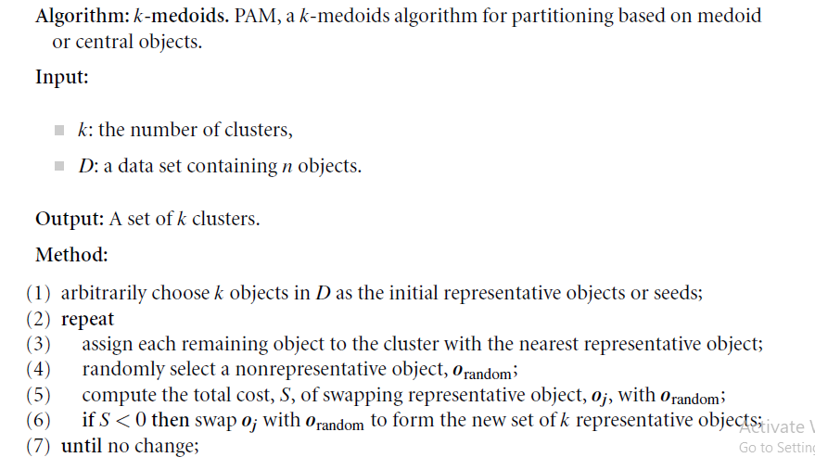
PAM – k-medoids Algorithm

Slide 24
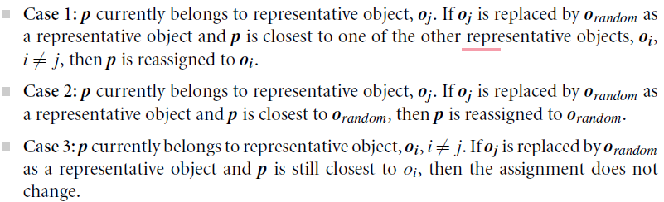

PAM – k-medoids Algorithm
To determine whether a non-representative object, o_{random}, is a good replacement for a current representative object, o_{j}, the following four cases are examined for each of the non-representative objects, p.

Slide 25
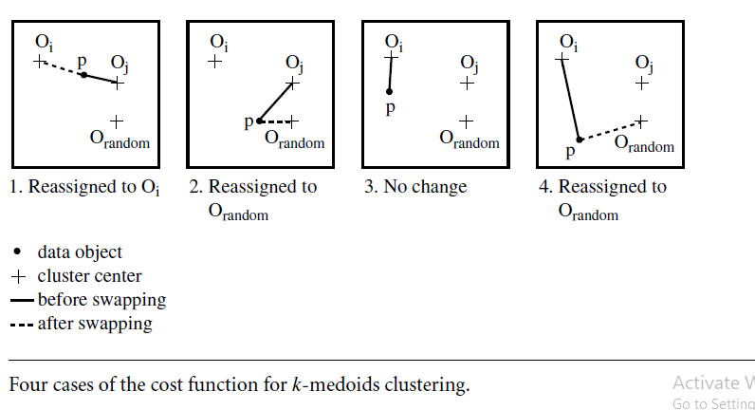

Slide 26
What Is the Problem with PAM?
PAM is more robust than k-means in the presence of noise and outliers because a medoid is less influenced by outliers or other extreme values than a mean.
PAM works efficiently for small data sets but does not scale well for large data sets.
O(k(n-k)² ) for each iteration
where n is # of data,k is # of clusters
To deal with larger data - Sampling based method,
CLARA(Clustering LARge Applications)

Slide 27
CLARA (Clustering Large Applications)
A small portion of the actual data is chosen as a representative of the data.
Medoids are then chosen from this sample using PAM
It draws multiple samples of the data set, applies PAM on each sample, and gives the best clustering as the output
Strength: deals with larger data sets than PAM
Weakness:
Efficiency depends on the sample size
A good clustering based on samples will not necessarily represent a good clustering of the whole data set if the sample is biased.
Complexity is O(ks²+k(n-k)) where s is the size of the sample, k is the number of clusters, and n is the total number of objects.

Slide 28
CLARANS (“Randomized” CLARA)
CLARANS (A Clustering Algorithm based on Randomized Search)
CLARANS draws sample of neighbors dynamically.
The clustering process can be presented as searching a graph where every node is a potential solution, that is, a set of k medoids
If the local optimum is found, CLARANS starts with new randomly selected node in search for a new local optimum
It is more efficient and scalable than both PAM and CLARA

Slide 29
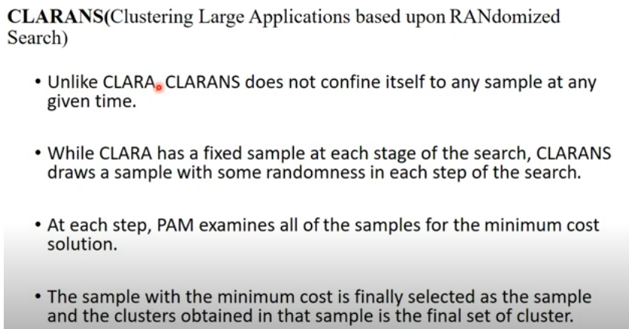
CLARANS (“Randomized” CLARA)

Slide 30
CLARANS
CLARANS has been experimentally shown to be more effective than both PAM and CLARA.
It can be used to find the most “natural” number of clusters using a silhouette coefficient—a property of an object that specifies how much the object truly belongs to the cluster.
CLARANS also enables the detection of outliers.
The computational complexity of CLARANS is about O(n2), where n is the number of objects.
Its clustering quality is dependent on the sampling method used.
The ability of CLARANS to deal with data objects that reside on disk can be further improved by focusing techniques that explore spatial data structures, such as R*-trees.

Slide 31
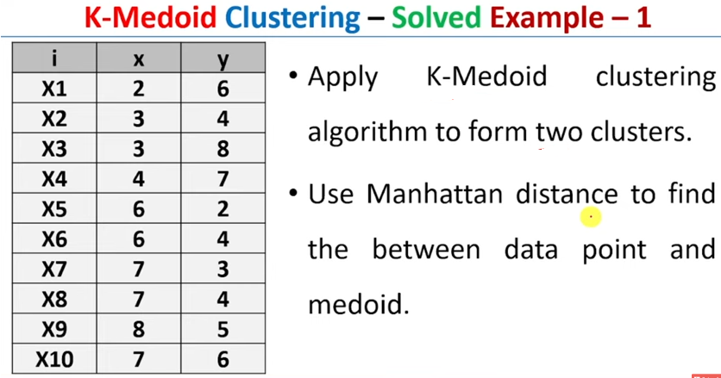

Slide 32
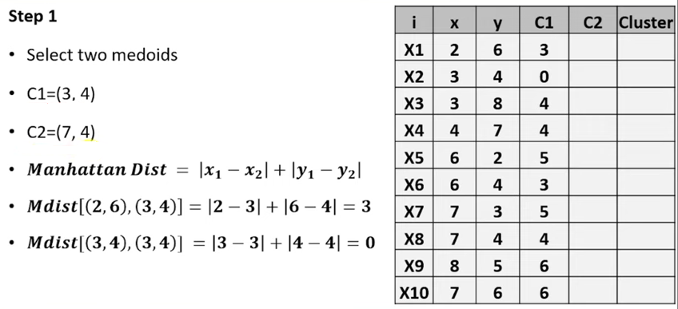
K-medoids clustering
(Random selection)

Slide 33
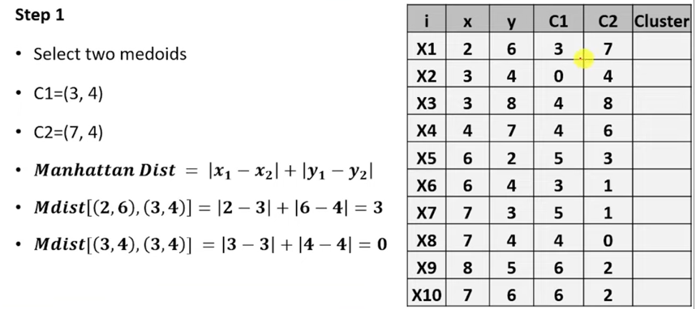
K-medoids clustering
(Random selection)

Slide 34
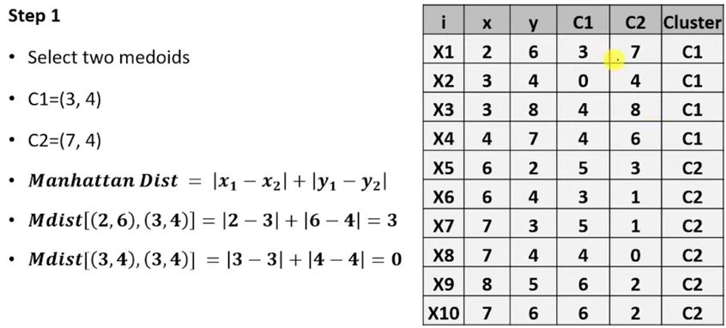
K-medoids clustering
(Random selection)

Slide 35
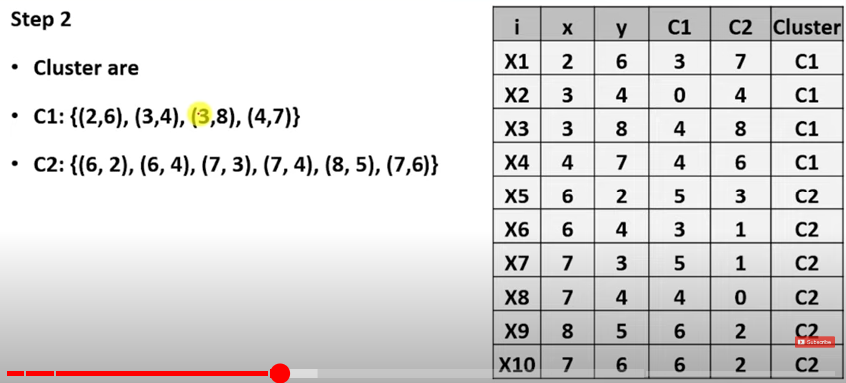
K-medoids clustering
(Random selection)

Slide 36
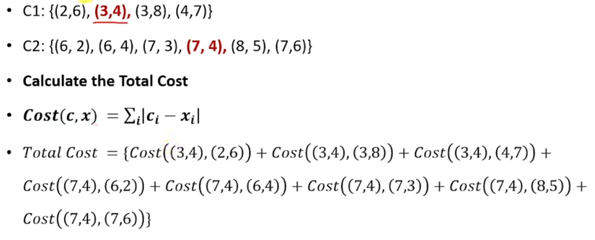
K-medoids clustering
(Random selection)

Slide 37
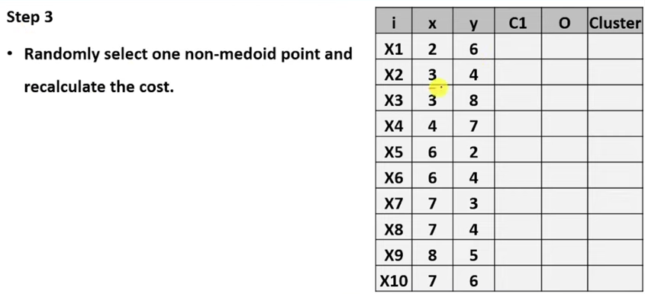

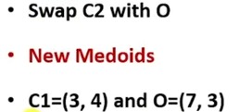
K-medoids clustering

Slide 38
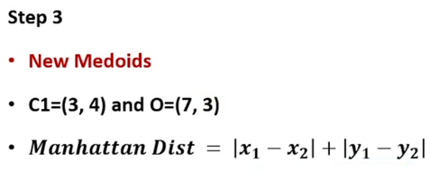
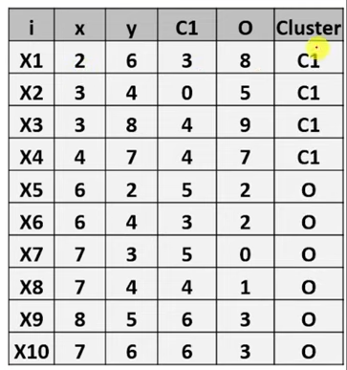
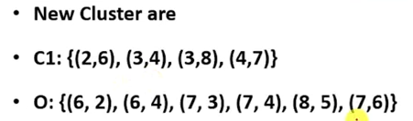
K-medoids clustering

Slide 39
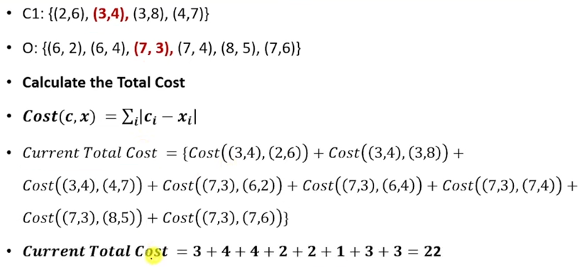
K-medoids clustering

Slide 40
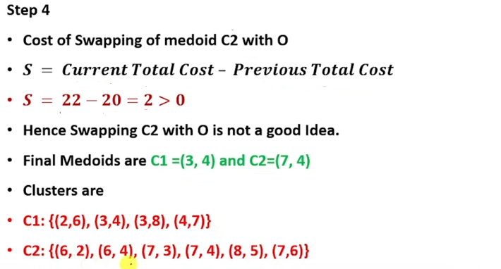
K-medoids clustering

